Slide 1
Supplies you need today:
Writer’s notebooks
Pens/pencils

Slide 2
Agenda
Logistics
Prewrite
Adichie’s TED Talk
Discussion
Break
Work on projects
Partner Feedback

Slide 3
Logistics
Contracts Due
Projects due Oct 1st

Slide 4
Writer’s Notebook: 9/25/14
Describe a time that you made an assumption about someone else that turned out to be wrong. What was the assumption? How did you discover you were wrong? Describe the encounter.
Describe a time that someone made an assumption about you. What was the assumption? How did it feel? Describe the encounter.
Notes:
5min

Slide 5
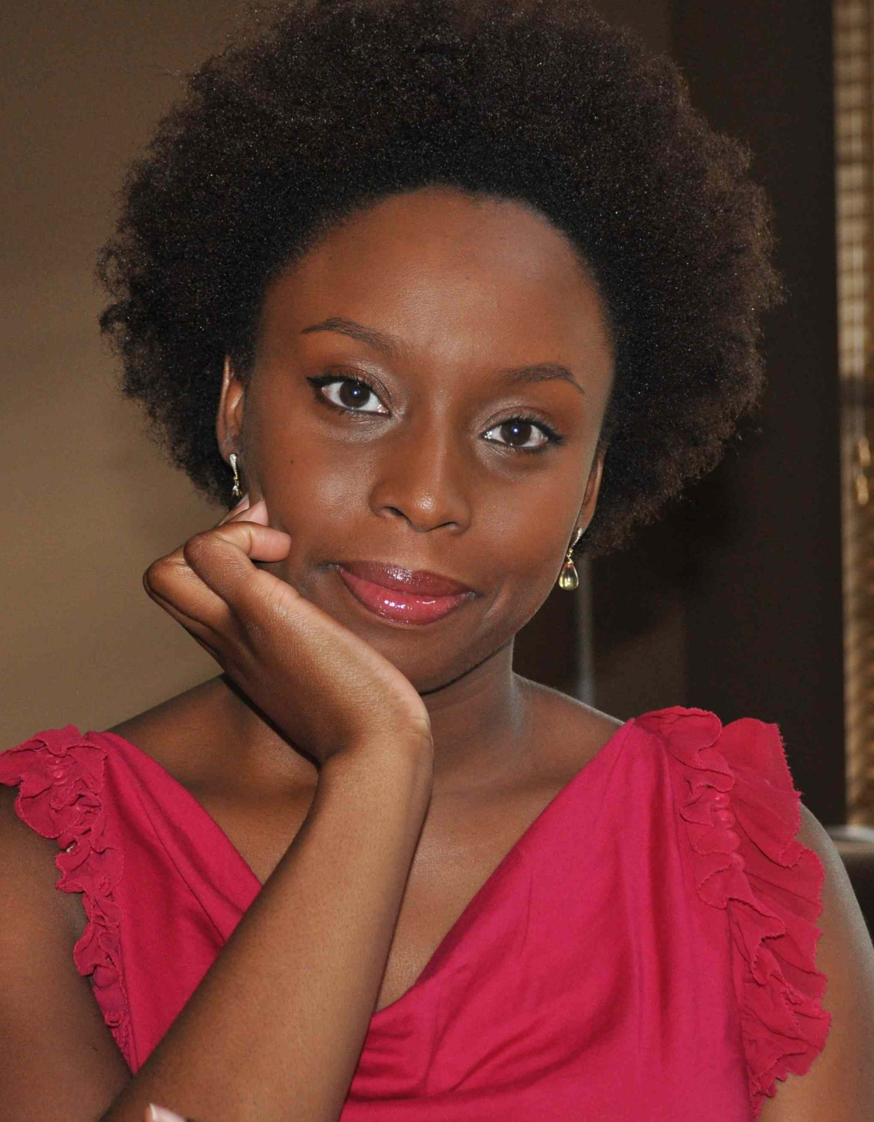
Chimamanda Ngozi Adichie
Nigerian writer
Two novels: Half a Yellow Sun& Americanah
are both prize winning
Notes:
Until 10:45

Slide 6
Project
Requirements:
*symbols
* 3D
*represent At least 2 of your cultural groups
*writing to explain symbols
*presented in front of class on Oct 1st
2. 30min to work at end need:
-Sketch or part of it constructed
-writing started
Notes:
7min to go over

Slide 7
Partner Feedback
What’s confusing/could be improved/needs refinement?
What’s powerful/beautiful/ well-done?
Any other feedback?
Notes:
7min to go over (break at 11:!5 for 15min)

